Slide 1

DriverPass System Analysis
Maurion Caldwell

Slide 2

System Requirements
Students can schedule driving lessons online
Students can take and receive results for practice tests
System must be easy to use on common devices
System must be reliable and protect user information
Notes:
For the DriverPass system, we focused on both what the system needs to do and how well it needs to perform.
First, from a functional standpoint, the system allows students to schedule driving lessons online by viewing available time slots and confirming a lesson with an instructor. This removes the need for phone calls and makes scheduling faster and more convenient.
The system also allows students to take online practice tests and immediately receive their results, helping them prepare more effectively for their driving exams.
From a nonfunctional standpoint, the system is designed to be easy to use on common devices such as laptops, tablets, and smartphones, so students can access it wherever they are.
In addition, reliability and security are important. The system ensures that lesson bookings are accurate, prevents scheduling conflicts, and protects student and instructor information from unauthorized access.
Together, these requirements ensure that DriverPass meets its goal of providing a simple, dependable, and user-friendly experience for both students and instructors.

Slide 3
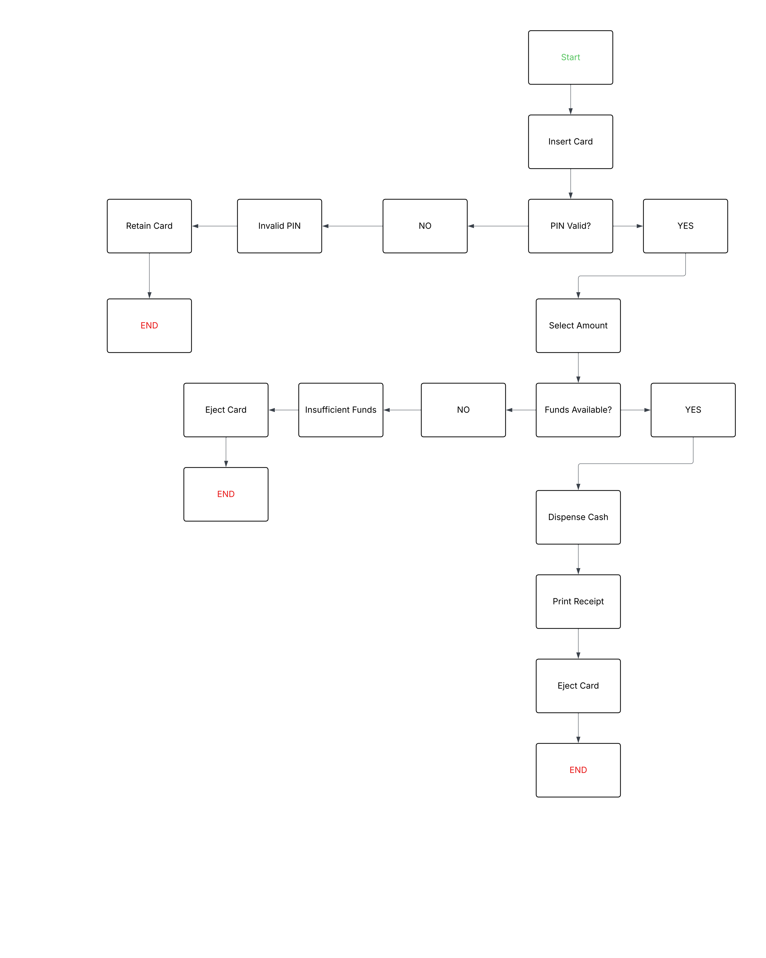
Use Case Diagram
Notes:
This diagram shows how different people interact with the DriverPass system and how the system supports their needs. The primary user of the system is the student, who uses DriverPass to prepare for driving tests and schedule driving lessons. Students can log in, take practice tests, review their results, and schedule lessons based on available instructor times. These features are designed to make learning convenient and flexible while helping students feel confident and prepared.
The system also supports instructors by allowing them to manage their availability and receive lesson requests. When a student schedules a lesson, the system checks instructor schedules to prevent conflicts and ensures that only open time slots can be selected. This helps instructors manage their time efficiently while keeping scheduling accurate and reliable.
Behind the scenes, DriverPass handles important processes such as storing student information, tracking lesson bookings, and managing test results. This ensures that all data remains organized, up to date, and accessible when needed. By centralizing these tasks, the system reduces errors and improves consistency across the platform.
Overall, this design meets DriverPass’s needs by providing a simple experience for students, an organized scheduling process for instructors, and a dependable system that keeps everything running smoothly. The diagram highlights how DriverPass connects learning, scheduling, and data management into one cohesive system that supports both education and efficiency.

Slide 4
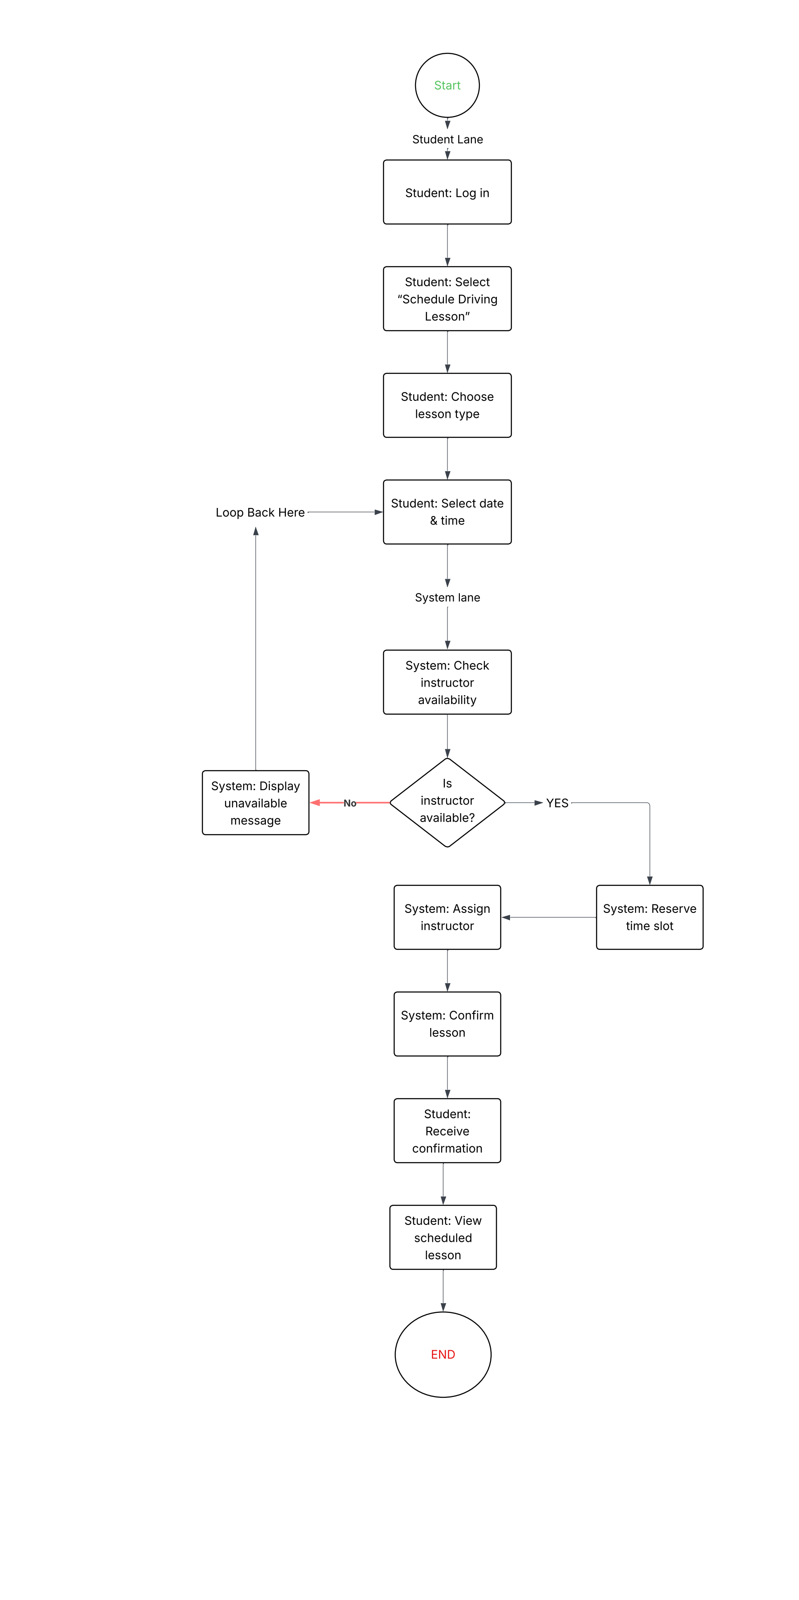
Activity Diagram
Notes:
This diagram shows how a student schedules a driving lesson from start to finish. The process begins when the student logs into the system and chooses the option to schedule a driving lesson. The student then selects the type of lesson they want and picks a preferred date and time.
Once those choices are made, the system checks whether an instructor is available at the selected time. If no instructor is available, the system lets the student know and allows them to choose a different date or time. This ensures the student is not stuck and can easily try another option.
If an instructor is available, the system reserves the time slot, assigns an instructor, and confirms the lesson. The student then receives a confirmation and can view the scheduled lesson in their account.
This design helps DriverPass meet its goals by making scheduling simple, flexible, and reliable. Students can clearly see their options, avoid scheduling conflicts, and receive immediate confirmation, which reduces confusion and improves the overall experience.

Slide 5
Security
User accounts require secure login to protect personal information
Only authorized users can schedule or manage lessons
Student and instructor information is stored securely
Scheduling actions are verified to prevent mistakes or conflicts
Confirmation messages help users verify correct bookings
Notes:
Security was an important part of the system’s design because DriverPass handles personal information and lesson schedules. To protect users, the system requires each student and instructor to log in before accessing their account. This ensures that only the right people can view or change their information.
The system also limits what users can do based on their role. For example, students can schedule lessons, but they cannot change instructor schedules directly. This helps prevent accidental or unauthorized changes.
All student, instructor, and lesson information is stored in a secure way so that personal details are not exposed. Before a lesson is confirmed, the system double-checks availability to avoid scheduling conflicts. Finally, confirmation screens and notifications help users immediately spot any issues, adding an extra layer of protection and trust.

Slide 6
System Limitations
Lesson availability depends on instructor schedules
Scheduling conflicts may still occur during high demand times
Internet access is required to use all system features
Notifications rely on accurate contact information
System features are limited to current DriverPass services
Notes:
While the DriverPass system is designed to be reliable and easy to use, there are a few limitations to be aware of. Lesson availability depends entirely on instructor schedules, so during busy periods, students may have fewer time options to choose from.
Because multiple users may be scheduling lessons at the same time, short delays or conflicts can still occur, especially during peak hours. The system works to reduce this, but it cannot completely eliminate it.
The system also requires an internet connection, meaning users will not be able to schedule lessons or take practice tests while offline. Notifications such as confirmations depend on users keeping their contact information up to date.
Finally, the system only supports the services currently offered by DriverPass. Adding new features or expanding services would require additional updates in the future.

